Slide 1

Unit – 1: Introduction
Mobile Computing and Wireless Communication (2170710)
Prof. Maulik Trivedi
 9998265805
→ maulik.trivedi@darshan.ac.in
Computer Engineering | Darshan Institute of Engineering & Technology

Slide 2
Outline
Introduction
Mobile Computing & Wireless Communication
Transmission Media
Multiplexing (Covered in Unit - 2)
LANs, MANs, and WANs
Switching Techniques
The OSI Model
The TCP/IP Protocol Architecture

Slide 3
Introduction
Mobile Computing is a technology that allows transmission of data, voice and video via a computer or any other wireless enabled device without having to be connected to a fixed physical link.
The main concept involves:
Mobile communication
Mobile hardware
Mobile software
Mobile communication refers to the infrastructure put in place to ensure that seamless and reliable communication goes on.
These would include devices such as protocols, services, bandwidth, and portals necessary to facilitate and support the stated services.

Slide 4
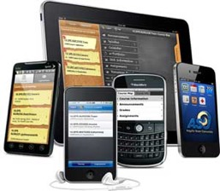
Introduction – Cont…
Mobile hardware includes mobile devices or device components that receive or access the service of mobility.
They would range from portable laptops, smartphones, tablet Pc's, Personal Digital Assistants.
Mobile software is the actual program that runs on the mobile hardware.
In other terms, it is the operating system of the appliance. It's the essential component that operates the mobile device.

Slide 5
Mobile Computing
Different names of mobile computing:
VHE – Virtual Home Environment
Anywhere, anytime information
Nomadic computing
Pervasive computing
Ubiquitous computing
Global service portability
Wearable computers
Context aware computing
Attribute of Mobility
Network Mobility
Bearer Mobility
Device Mobility
Session Mobility
Service Mobility
Host Mobility
User Mobility

Slide 6
Limitation of Mobile Computing
Limitations of the wireless network
Heterogeneity of fragmented networks
Frequent disconnections
Limited communication bandwidth
Limitations imposed by mobility
Lack of mobility awareness by system / applications
Route breakages
Limitations of the mobile computer
Short battery lifetime
Limited capacities (memory, processing speed, etc.)

Slide 7
Wireless Communication
Wireless communication involves the transmission of information over a distance without the help of wires, cables or any other forms of electrical conductors.
It is a broad term that incorporates all procedures and forms of connecting and communicating between two or more devices using a wireless signal through wireless communication technologies and devices.

Slide 8
Wireless Communication – Cont…
The transmitted distance can be anywhere between a few meters (for example, a television's remote control) and thousands of kilometers (for example, radio communication).
Wireless communication can be used for cellular telephony, wireless access to the internet, wireless home networking, and so on.
Examples of applications of wireless technology include
GPS Units
Garage Door Openers
Wireless keyboard-mouse
Headsets
Radio Receivers
Satellite Television
Broadcast Television
Cordless Telephones

Slide 9
Advantages
Cost effectiveness
Flexibility
Convenience
Speed
Accessibility
Constant Connectivity

Slide 10
Application & Services
There are six basic categories:
Personal (wallet, diary, etc.)
Perishable (news, sports, stock quotes, etc.)
Transaction oriented (bank transactions, mobile shopping, etc.)
Location specific (restaurant guide, map service, etc.)
Corporate (ERP, inventory, business alerts, etc.)
Entertainment (fun, games, etc.)

Slide 11
Transmission Media
A transmission media can be defined as any medium that can carry information from a source to a destination.
Transmission Media
Guided Media (Wired)
Unguided Media (Wireless)
Twisted-Pair Cable
Coaxial Cable
Fiber Optic Cable
Radio Wave
Microwave
Infrared Wave

Slide 12
Guided Media
Guided media are those that provide a wired - channel from one device to another.
Three Guided media commonly used for data transmission are:
Twisted Pair Cable
Coaxial Cable
Fiber Optic Cable

Slide 13
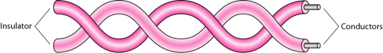
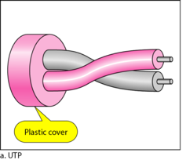
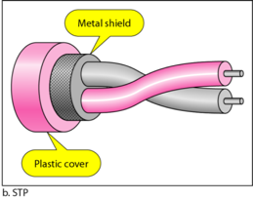
Twisted Pair Cable
Separately insulated
Twisted together
Two types of twisted pair cable
UTP(Unshielded Twisted Pair)
Ordinary telephone wired
Less expensive
Weak immunity against noise & interferences
Most used in two categories: Cat-3 & Cat-5
STP(Shielded Twisted Pair)
An extra metallic shield on each pair
Relatively more expensive
Better performance than UTP

Slide 14
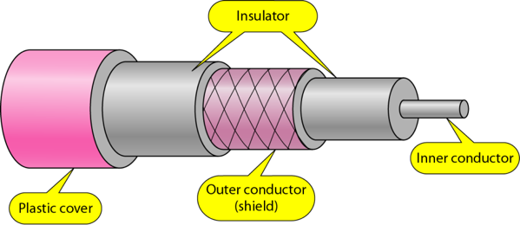
Coaxial Cable
Outer conductor is braided shield
Inner conductor is solid metal
Separated by insulating material
Used in television, long distance telephone transmission
High bandwidth and excellent noise immunity

Slide 15
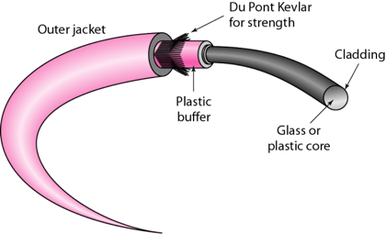
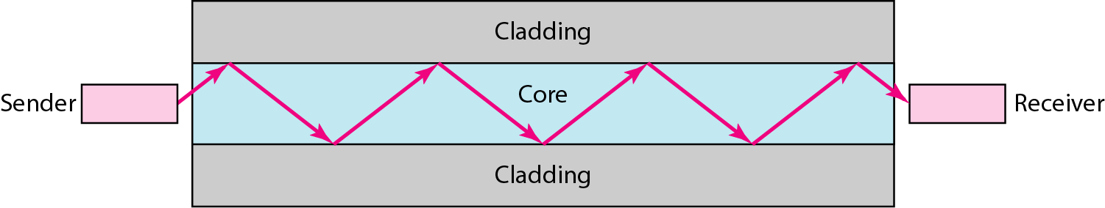
Fiber Optic Cable
Glass or plastic core
Laser or light emitting diode
Small size & weight
Used in high bandwidth network
High data rate & lower attenuation

Slide 16
Unguided Media
Unguided media transmit electromagnetic waves without using a physical conductor.
This type of communication is often referred to as wireless communication.
Radio wave
Microwave
Infrared Wave

Slide 17
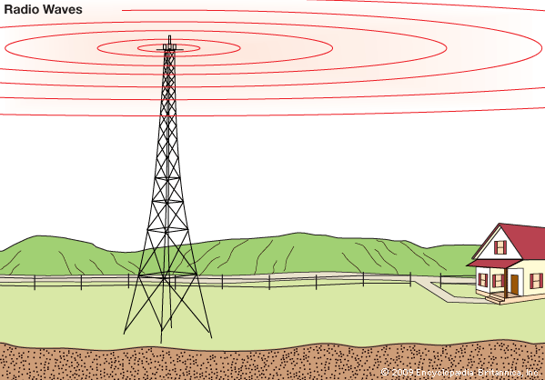
Radio wave
Highly regulated
Omni directional antennas
Radio waves are used for multicast communications, such as radio and television, and paging systems
Penetrate through walls

Slide 18
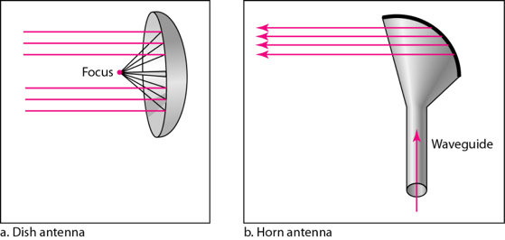
Microwave
Use directional antennas - point to point line of sight communications
Microwave communication
Used for unicast communication such as cellular telephones, satellite networks
Higher frequency ranges cannot penetrate walls

Slide 19
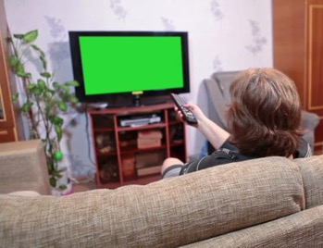
Infrared wave
Infrared signals can be used for short-range communication in a closed area using line-of-sight propagation
Used on televisions, VCRs, and stereos all use infrared communication.
Relatively directional
Cheap, Easy to build but they do not pass through solid objects

Slide 20
Communication Network
Communication networks can be categories by their size as well as their purpose.
The size of a network can be expressed by the geographic area.
Some of the different networks based on size are:
LAN – Local Area Network
MAN – Metropolitan Area Network
WAN – Wide Area Network

Slide 21
Local Area Network
A local area network (LAN) is a computer network that interconnects computers within a limited area such as a residence, school, laboratory, university campus or office building.

Slide 22
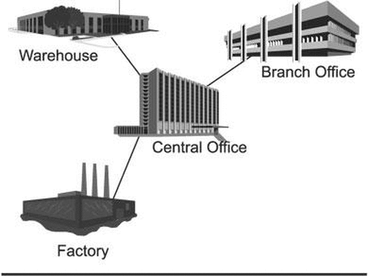
Metropolitan Area Network
A metropolitan area network (MAN) is a computer network that interconnects with computer in a metropolitan area like city.
MAN is a larger than LAN but smaller than the area covered by a WAN.
It is also used to interconnection of several local area network.
Navagam
Morbi
Rajkot
Shapar

Slide 23
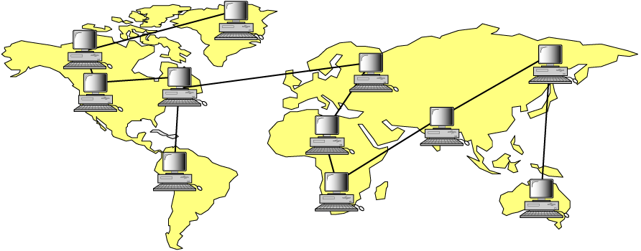
Wide Area Network
A wide area network (WAN) is a computer network that exists over a large-scale geographical area.
A WAN connects different networks, including local area networks (LAN) and metropolitan area networks (MAN).
It may be located with in a state or a country or it may be interconnected around the world.

Slide 24
Types of Computer Networks
Basis Of Comparison | LAN | MAN | WAN
Full Name | Local Area Network | Metropolitan Area Network | Wide Area Network
Meaning | A network that connects a group of computers in a small geographical area | It covers relatively large region such as cities, towns | It spans large locality & connects countries together. e.g. Internet
Ownership of Network | Private | Private or Public | Private or Public (VPN)
Design and Maintenance | Easy | Difficult | Difficult
Propagation Delay | Short | Moderate | Long
Speed | High | Moderate | Low
Equipment Used | NIC, Switch, Hub | Modem, Router | Microwave, Radio Transmitter & Receiver
Range(Approximately) | 1 to 10 km | 10 to 100 km | Beyond 100 km
Used for | College, School, Hospital | Small towns, City | State, Country, Continent

Slide 25
Switching
Defines the connection of different network segments together and the process to transmit the data packets across the network.
It is implemented through the use of switching techniques.
Switched
Networks
Circuit-Switched
Networks
Packet-Switched
Networks

Slide 26
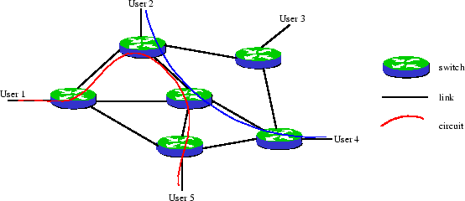
Circuit Switched Network
A dedicated channel has to be established before the call is made between users.
The channel is reserved between the users till the connection is active.
For half duplex(one way) communication, one channel is allocated and for full duplex(two way) communication, two channels are allocated.
It is mainly used for voice communication requiring real time services without delay.

Slide 27
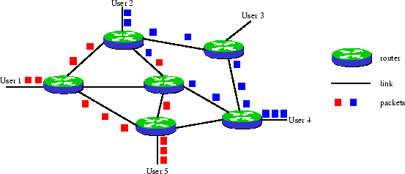
Packet Switched Network
It is not required to establish the connection initially.
The connection/channel is available to use by users. But when traffic or number of users increases then it will lead to congestion in the network.
Packet switched networks are mainly used for data and voice applications requiring non-real time scenarios.

Slide 28
Differences
Circuit Switching | Packet Switching
Dedicated path between source and destination | No dedicated path
All packets use same path | Packets travel independently
Reserve the entire bandwidth in advance | Does not reserve bandwidth
Bandwidth wastage | No bandwidth wastage
No store and forward transmission | Supports store and forward transmission

Slide 29
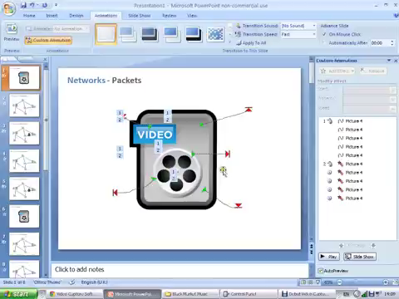
Switching Network

Slide 30
Protocol Layers

Slide 31
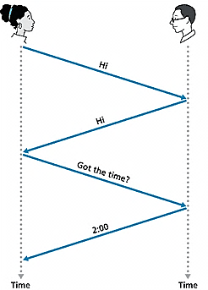
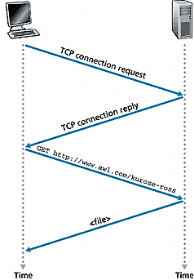
What is Protocol?
Human Protocol(Language)
“what’s the time?”
“I have a question”
Introduction Talk
Network Protocol
Set of rules
machines rather than humans
all communication activity in Internet governed by protocols.
Protocols define format, order of message sent and received among network entities, and actions taken on message transmission and receipt

Slide 32
Protocols Layers
To deals with connecting systems that are open for communication with other systems.
OSI Layer Model (Open Systems Interconnection)
Developed by the International Standards Organization (ISO) with seven different layers.
Physical Layer
Data Link Layer
Network Layer
Transport Layer
Session Layer
Presentation Layer
Application Layer

Slide 33
Example – Air Plane Travel
Departure
Arrival
ticket (purchase)
baggage (check)
gates (load)
runway takeoff
airplane routing
ticket (complain)
baggage (claim)
gates (unload)
runway landing
airplane routing
airplane routing

Slide 34
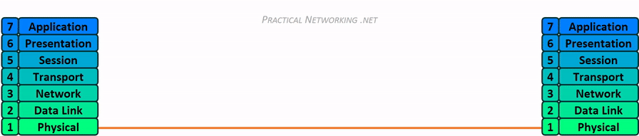
How OSI Layer Works?

Slide 35
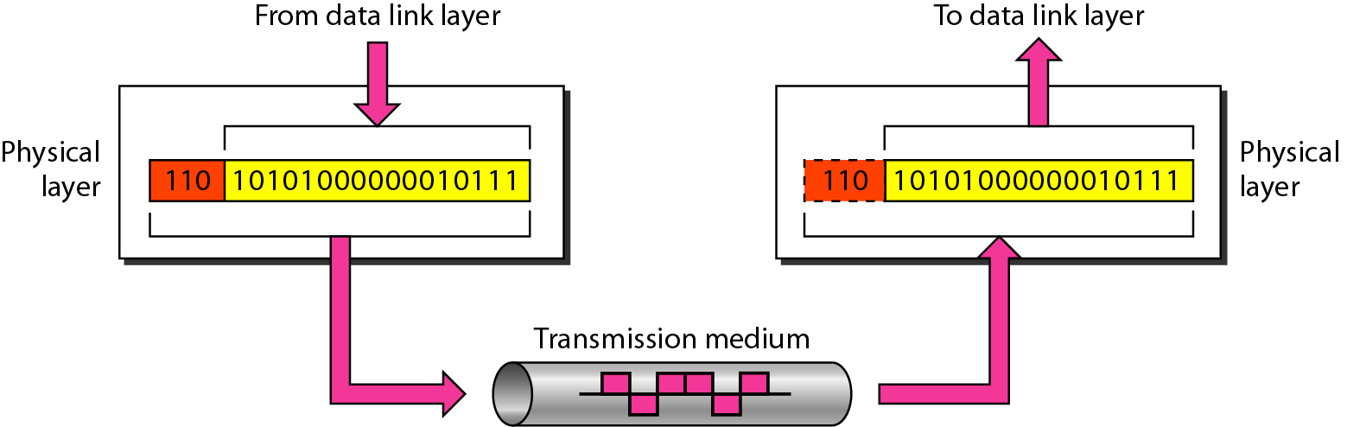
Physical Layer
The physical layer is responsible for movements of individual bits from one hop (node) to the next.

Slide 36
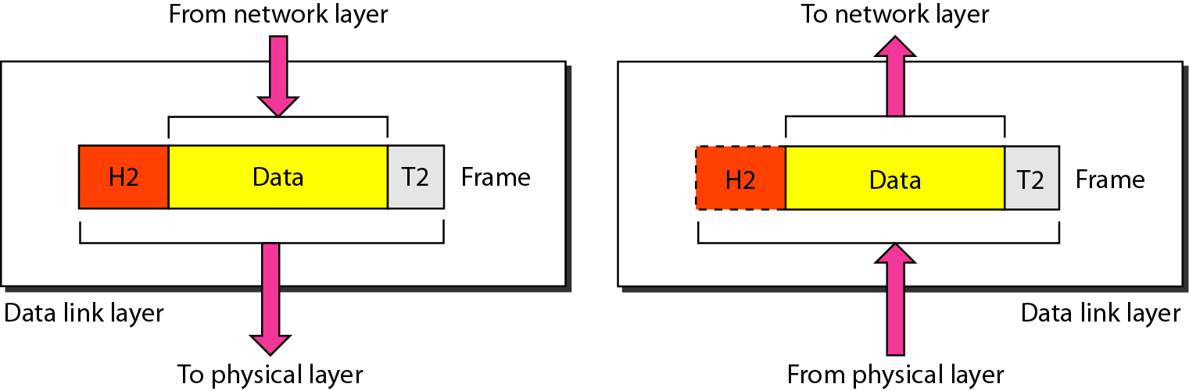
Data Link Layer
The data link layer is responsible for moving frames from one hop (node) to the next.

Slide 37
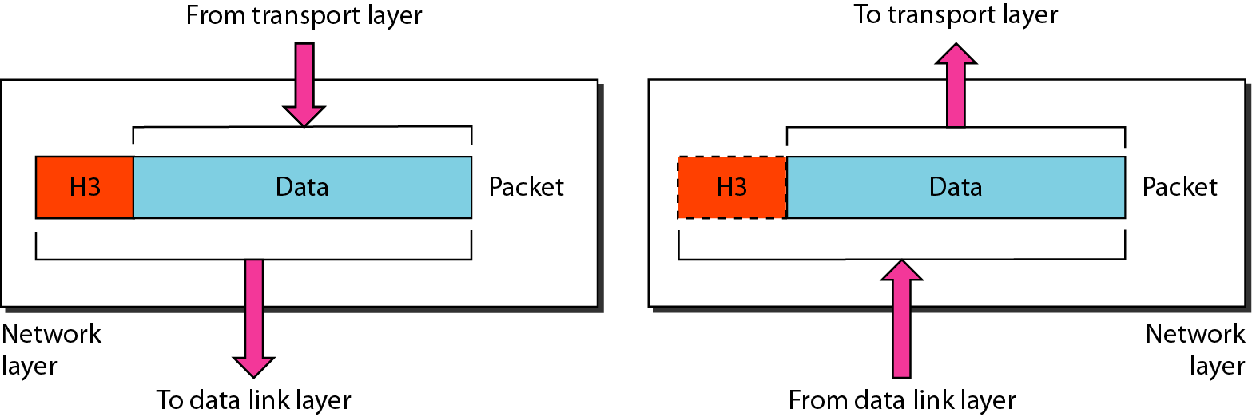
Network Layer
The network layer is responsible for the delivery of individual packets from the source host to the destination host.

Slide 38
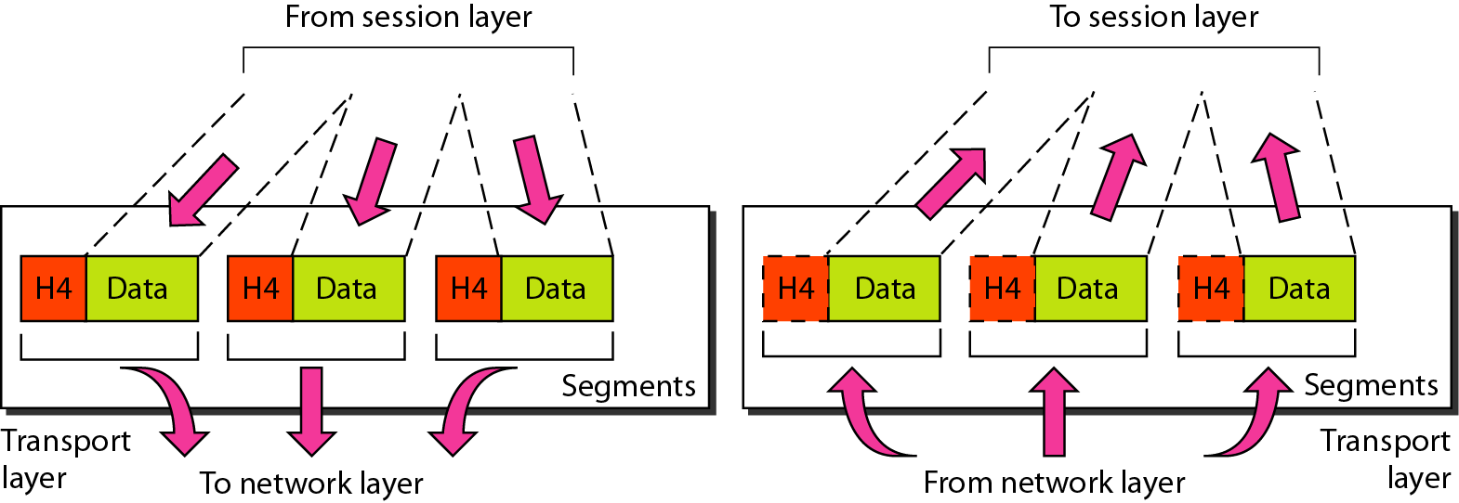
Transport Layer
The transport layer is responsible for the delivery of a message from one process to another.

Slide 39
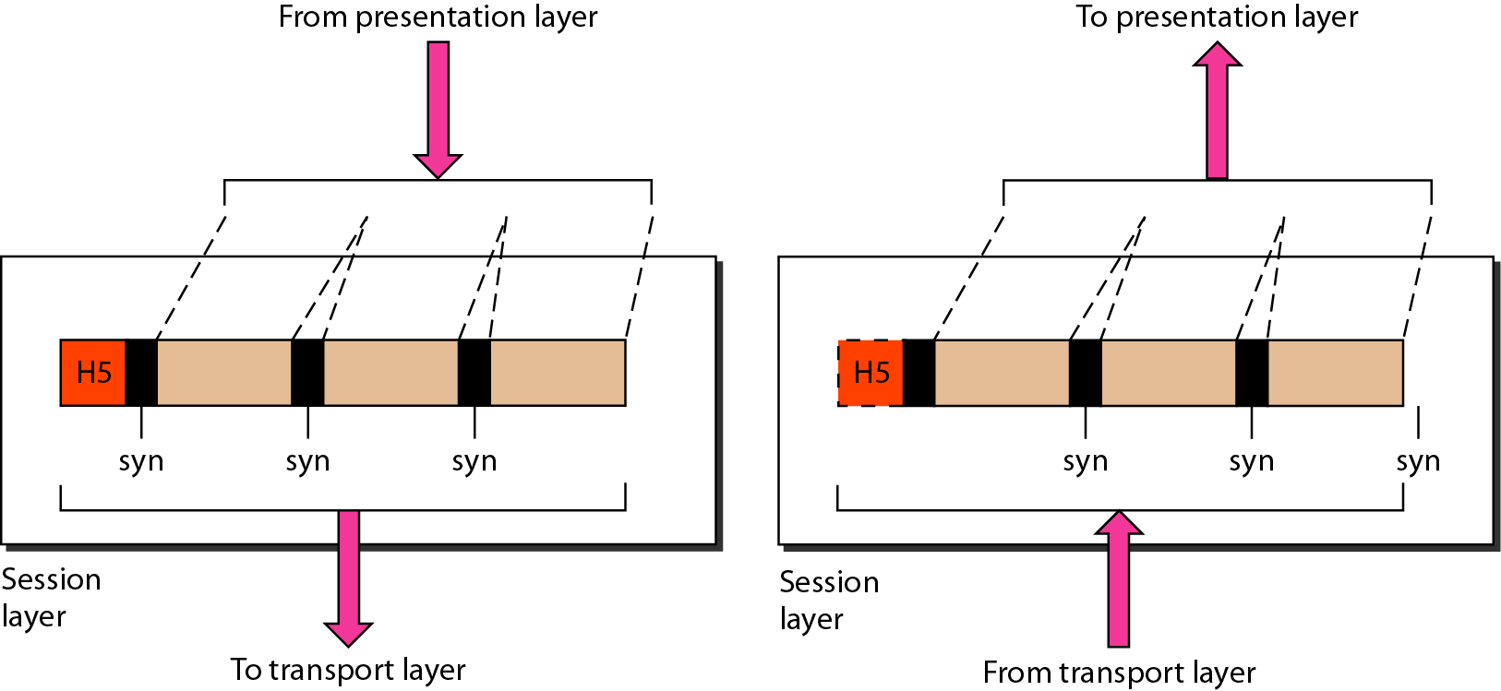
Session Layer
The session layer is responsible for dialog control and synchronization.

Slide 40
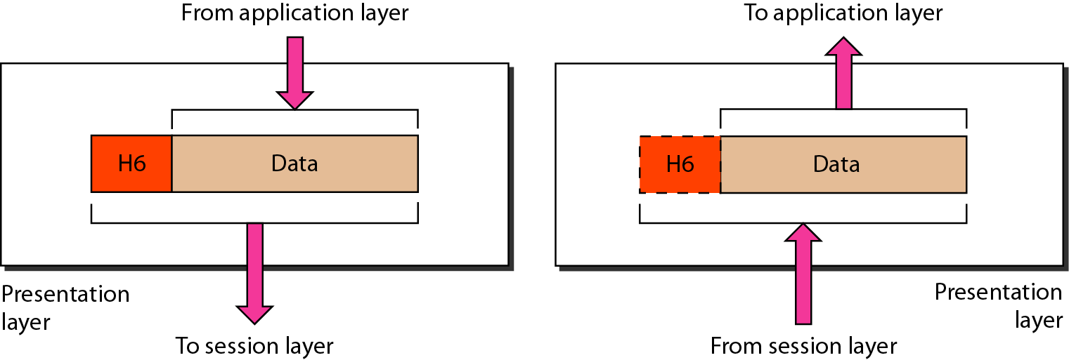
Presentation Layer
The presentation layer is responsible for translation, compression, and encryption.

Slide 41
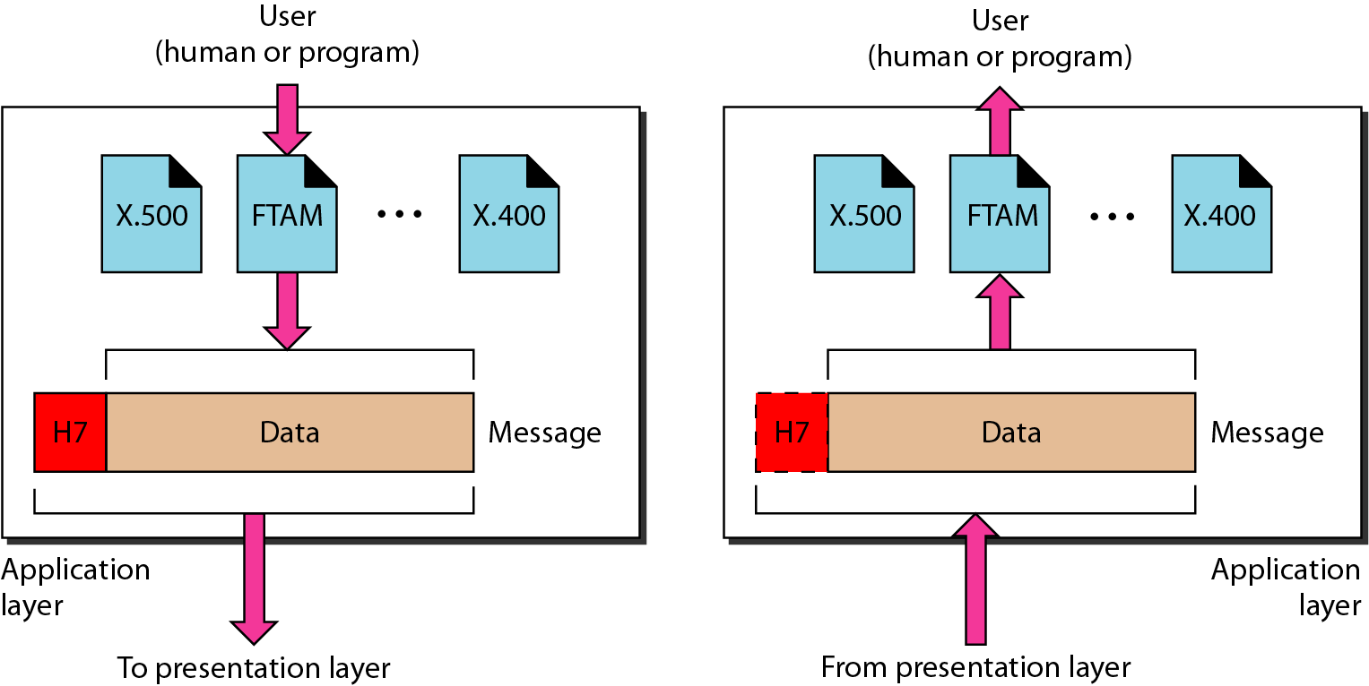
Application Layer
The application layer is responsible for providing services to the user.

Slide 42
Summary – OSI Layer
To allow access to network resource
Application
To translate, encrypt and compress data
Presentation
To establish, manage and terminate sessions
To provide reliable process-to-process message delivery and error recovery
Session
Transport
To move packets from source to destination; To provide internetworking
Network
To organize bits into frames; To provide hop-to-hop delivery
Data link
To transmit bits over a medium; To provide mechanical & electrical specification
Physical

Slide 43
TCP/IP Reference Model (Transmission Control Protocol/Internet Protocol)
It was originally defined as having five layers:
TCP/IP is a set of protocols developed to allow cooperating computers to share resources across the network.
Application Layer
Transport Layer
Network Layer
Data Link Layer
Physical Network

Slide 44
TCP/IP Model Architecture

Slide 45
Difference
OSI (Open System Interconnection) | TCP/IP (Transmission Control Protocol/ Internet Protocol)
OSI provides layer functioning and also defines functions of all the layers | TCP/IP model is more based on protocols and protocols are not flexible with other layers
In OSI model the transport layer guarantees the delivery of packets | In TCP/IP model the transport layer does not guarantees delivery of packets
Follows horizontal approach | Follows vertical approach
OSI model has a separate presentation layer | TCP/IP doesn’t have a separate presentation layer
OSI is a general model | TCP/IP model cannot be used in any other application

Slide 46
Difference - Cont…
OSI (Open System Interconnection) | TCP/IP (Transmission Control Protocol/ Internet Protocol)
Network layer of OSI model provide both connection oriented and connectionless service | The Network layer in TCP/IP model provides connectionless service
OSI model has a problem of fitting the protocols in the model | TCP/IP model does not fit any protocol
Protocols are hidden in OSI model and are easily replaced as the technology changes | In TCP/IP, replacing protocol is not easy
OSI model defines services, interfaces and protocols very clearly and makes clear distinction between them | In TCP/IP, it is not clearly separated its services, interfaces and protocols
It has 7 layers | It has 5 layers

Slide 47
Summary
Signals for Conveying Information (Analog and Digital Signal)
Analog and Digital Data Transmission (Continue, Discrete)
Channel Capacity (Bandwidth, Data Rate, Noise, Error Rate)
Transmission Media (Cables)
LANs, MANs, and WANs
Switching Techniques (Circuit and Packet Switching)
The OSI Model (Seven Layers)
The TCP/IP Protocol Architecture (Protocols)

Slide 48
Thank You

